Slide 1

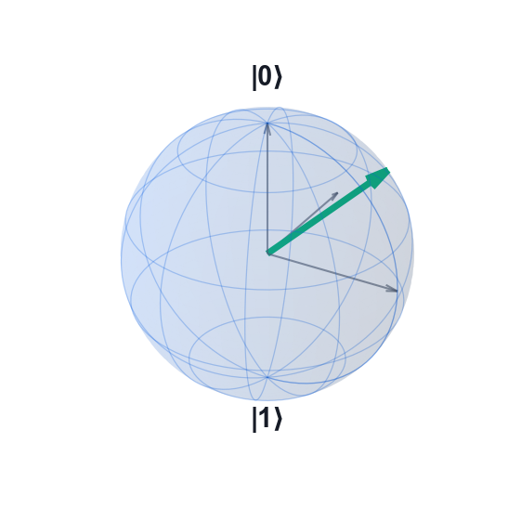
COURSE SLIDES · NON-WSQ
Quantum Computing Fundamentals for Beginners
Course Code: C882
Conducted by Tertiary Infotech Academy Pte Ltd · UEN 201200696W
Version v1.0 · 2 October 2026
© 2026 Tertiary Infotech Academy Pte Ltd. All rights reserved. · www.tertiarycourses.com.sg

Slide 2
COURSE ADMINISTRATION
Welcome & Housekeeping
Quantum Computing Fundamentals for Beginners · C882
© 2026 Tertiary Infotech Academy Pte Ltd
1

Slide 3
YOUR TRAINER · GENERAL
About the Trainer
NAME
____________________________________________
?
TITLE / DESIGNATION
____________________________________________
QUALIFICATIONS
____________________________________________
Your Trainer
AREAS OF EXPERTISE
____________________________________________
General Trainer template —
to be completed by the trainer
TRAINING & INDUSTRY EXPERIENCE
____________________________________________
CONTACT
____________________________________________
Quantum Computing Fundamentals for Beginners · C882
© 2026 Tertiary Infotech Academy Pte Ltd
2

Slide 4
YOUR TRAINER
About the Trainer
ROLE
Principal Trainer, Tertiary Infotech Academy Pte Ltd
AA
QUALIFICATIONS
PhD; ACTA / DACE certified adult educator.
EXPERTISE
Quantum computing, quantum algorithms, machine learning and data analytics.
Dr Alfred Ang
DELIVERS
Courses on quantum computing, quantum cryptography, Python and AI.
Principal Trainer
Tertiary Infotech Academy Pte Ltd
FOUNDER
Founder and lead instructor at Tertiary Infotech / Tertiary Courses.
Quantum Computing Fundamentals for Beginners · C882
© 2026 Tertiary Infotech Academy Pte Ltd
3

Slide 5
ICE-BREAKER
Let's Know Each Other
Your name and organisation
Tell us your role and what your team does.
Your background
Any physics, mathematics or programming experience — none is required.
1
2
Why quantum
What drew you to quantum computing?
Your goal
What do you want to be able to build by the end of Day 2?
3
4
Quantum Computing Fundamentals for Beginners · C882
© 2026 Tertiary Infotech Academy Pte Ltd
4

Slide 6
HOUSEKEEPING
Ground Rules
Set your mobile phone to silent mode.
Participate actively — no question is too small.
1
2
Respect each other's views; agree to disagree.
Exit quietly for a phone call or toilet break.
3
4
Be punctual; return from breaks on time.
Full attendance — attend both days to get the most from the course.
5
6
Quantum Computing Fundamentals for Beginners · C882
© 2026 Tertiary Infotech Academy Pte Ltd
5

Slide 7
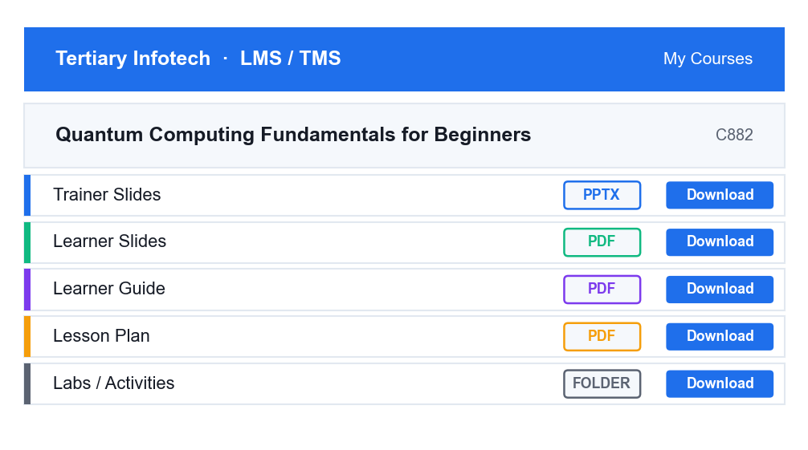
LMS / TMS · COURSE PORTAL
Download Your Course Material
https://lms-tms.tertiaryinfotech.com
1
Open https://lms-tms.tertiaryinfotech.com in your browser.
2
Sign in with the account e-mailed to you before the course.
3
Open this course: Quantum Computing Fundamentals for Beginners.
4
Download the Learner Slides, Learner Guide and Lab files.
5
Keep them open — you will refer to them in every lab.
Download everything at the start of Day 1 — you will use them throughout the course.
Quantum Computing Fundamentals for Beginners · C882
© 2026 Tertiary Infotech Academy Pte Ltd
6

Slide 8
SCHEDULE · 15 INSTRUCTIONAL HOURS
Lesson Plan — 2 Days, 7.5 hours per day
Day 1 · 9:30am – 5:30pm
Day 2 · 9:30am – 5:30pm
• Day 1 — Quantum Principles, States and Gates
– Welcome · Introductions
– Topic 1: Introduction to Quantum Computing (Labs 1–3)
– Lunch Break
– Topic 2: Quantum States and Gates (Labs 4–7)
– End of Day 1
• Day 2 — Quantum Algorithms and Applications
– Day 1 Recap
– Topic 3: Quantum Algorithms (Labs 8–13)
– Lunch Break
– Topic 4: Quantum Computing Applications (Labs 14–17)
– Course Summary · Q&A · Course Feedback
Quantum Computing Fundamentals for Beginners · C882
© 2026 Tertiary Infotech Academy Pte Ltd
7

Slide 9
FOUR TOPICS · 17 HANDS-ON LABS
Course Outline
1
Topic 1 · Introduction to Quantum Computing
Key principles of quantum computing; quantum computing platforms.
2
Topic 2 · Quantum States and Gates
Quantum state vector representations; quantum circuits and quantum gates.
3
Topic 3 · Quantum Algorithms
Coding quantum algorithms; testing quantum algorithms.
4
Topic 4 · Quantum Computing Applications
Introduction to quantum error correction; introduction to quantum machine learning.
Quantum Computing Fundamentals for Beginners · C882
© 2026 Tertiary Infotech Academy Pte Ltd
8

Slide 10
01
TOPIC 01
Introduction to Quantum Computing
Key Principles of Quantum Computing · Quantum Computing Platforms
Quantum Computing Fundamentals for Beginners · C882
© 2026 Tertiary Infotech Academy Pte Ltd
9

Slide 11
WHAT IS A QUANTUM COMPUTER
A quantum computer computes with superposition and entanglement.
It performs calculations on qubits using two laws of the quantum-mechanical world that have no classical equivalent.
Quantum Computing Fundamentals for Beginners · C882
© 2026 Tertiary Infotech Academy Pte Ltd
10

Slide 12
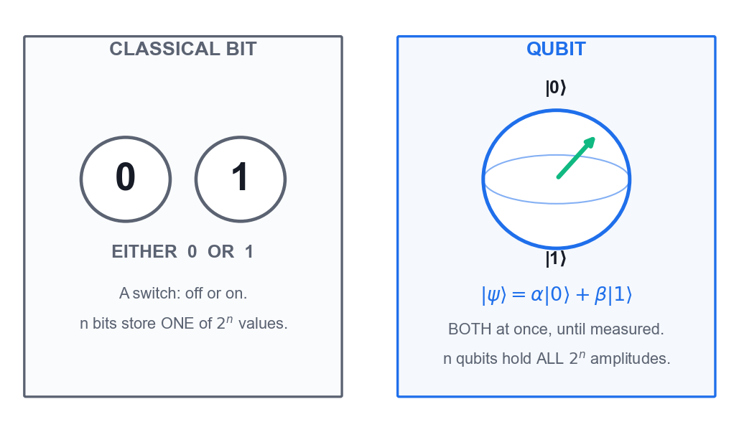
THE FUNDAMENTAL UNIT
Classical Bit vs Qubit
Classical bit
Exactly 0 or 1 — a switch that is either off or on. n bits store ONE of 2^n values.
Qubit
|0>, |1>, or a superposition a|0> + b|1> of both at once. n qubits hold ALL 2^n amplitudes.
Measurement
Collapses the qubit to 0 or 1 with probability |a|^2 and |b|^2 — you never see a and b directly.
Why it matters
The state space doubles with every qubit added — 50 qubits already exceed a supercomputer.
A qubit is a superposition of |0> and |1>; a bit is one or the other.
Quantum Computing Fundamentals for Beginners · C882
© 2026 Tertiary Infotech Academy Pte Ltd
11

Slide 13
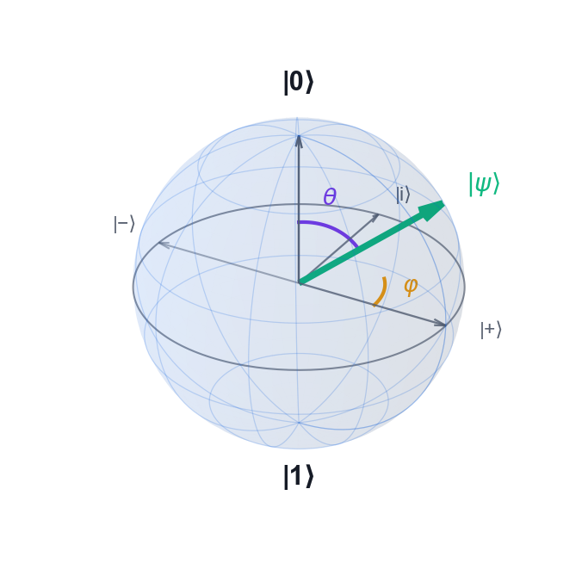
GEOMETRY OF A SINGLE QUBIT
Visualising a Qubit — The Bloch Sphere
North pole
|0> — measures 0 with certainty.
South pole
|1> — measures 1 with certainty.
Equator
Equal superpositions such as |+> and |-> — a 50/50 measurement.
Angles
theta sets the probability; phi sets the relative phase.
|psi> = cos(theta/2)|0> + e^(i.phi) sin(theta/2)|1>
Quantum Computing Fundamentals for Beginners · C882
© 2026 Tertiary Infotech Academy Pte Ltd
12

Slide 14
THE MATHEMATICS
Quantum State Vector Representation
Single qubit
Dirac notation
Two qubits
|psi> = a|0> + b|1>
|a|^2 + |b|^2 = 1
|0> = [1, 0]^T
|1> = [0, 1]^T
|psi> = a|00> + b|01>
+ c|10> + d|11>
The amplitudes a and b are complex numbers. Their squared magnitudes are the measurement probabilities, and they must sum to 1 (normalisation).
The computational basis states as column vectors. Every gate is a unitary matrix multiplying this vector.
n qubits need 2^n amplitudes. This exponential growth is the origin of quantum advantage — and of the difficulty of simulating quantum systems classically.
Quantum Computing Fundamentals for Beginners · C882
© 2026 Tertiary Infotech Academy Pte Ltd
13

Slide 15
HOW WE GOT HERE
Brief History of Quantum Computing
1980–82 · The idea
Benioff describes a quantum Turing machine; Feynman argues that simulating quantum physics needs a quantum computer.
1985 · Deutsch
David Deutsch formalises the universal quantum computer and the first quantum algorithm.
1
2
1994–96 · The algorithms
Shor factors integers exponentially faster; Grover searches quadratically faster.
2019 · Quantum supremacy
Google's Sycamore completes a sampling task claimed to be intractable classically.
3
4
2020s · NISQ era
IBM, Google, IonQ and others field 50–1,000+ noisy qubits on the cloud.
Today · Toward fault tolerance
Error-corrected logical qubits are demonstrated; useful fault tolerance is the next milestone.
5
6
Quantum Computing Fundamentals for Beginners · C882
© 2026 Tertiary Infotech Academy Pte Ltd
14

Slide 16
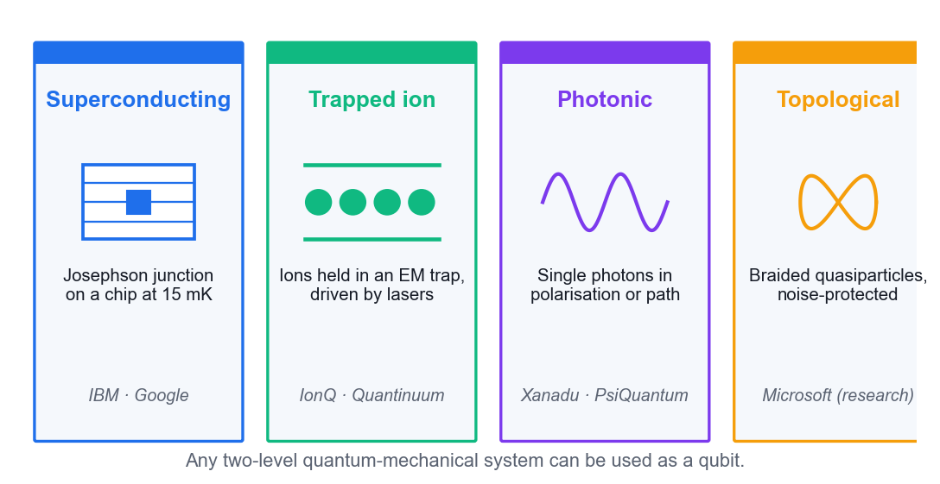
ANY TWO-LEVEL QUANTUM SYSTEM
Physical Implementation of a Qubit
Superconducting
Josephson-junction circuits at millikelvin temperatures — IBM and Google.
Trapped ion
Individual ions held in electromagnetic traps and driven by lasers — IonQ, Quantinuum.
Photonic
Single photons carrying the state in polarisation or path — Xanadu, PsiQuantum.
Topological
Braided quasiparticles, intrinsically protected from noise — Microsoft, still experimental.
Any two-level quantum-mechanical system can serve as a qubit.
Quantum Computing Fundamentals for Beginners · C882
© 2026 Tertiary Infotech Academy Pte Ltd
15

Slide 17
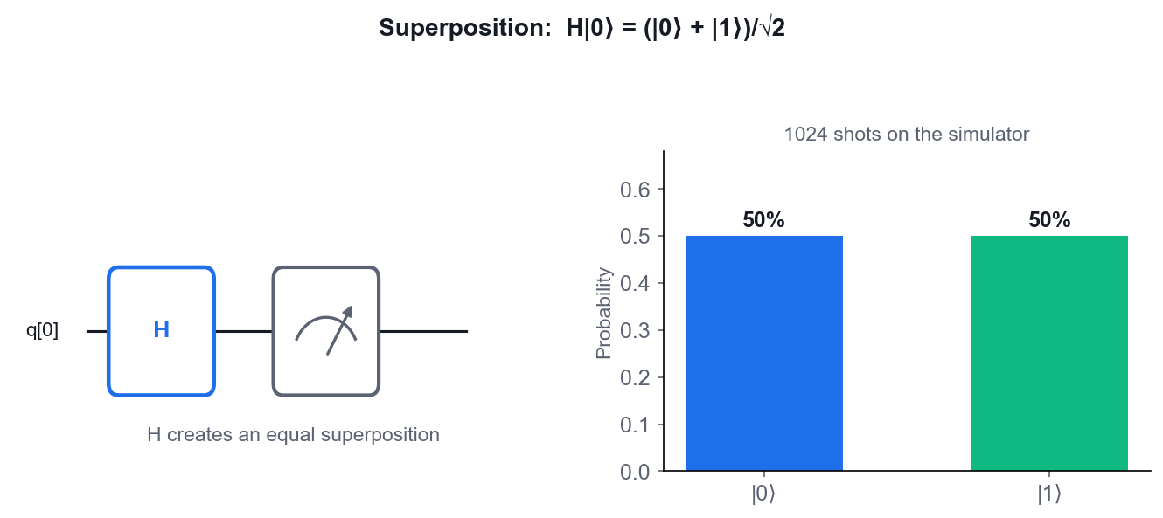
PRINCIPLE 1
Quantum Superposition
Both at once
Before measurement the qubit genuinely holds both |0> and |1> with amplitudes.
Interference
Amplitudes are complex — they add and CANCEL. Algorithms engineer cancellation of wrong answers.
Collapse
Measurement destroys the superposition; you get one classical bit, at random.
Not just probability
A classical coin is unknown, not undecided. Interference proves the difference.
H|0> = (|0> + |1>)/sqrt(2) — the Hadamard gate creates superposition.
Quantum Computing Fundamentals for Beginners · C882
© 2026 Tertiary Infotech Academy Pte Ltd
16

Slide 18
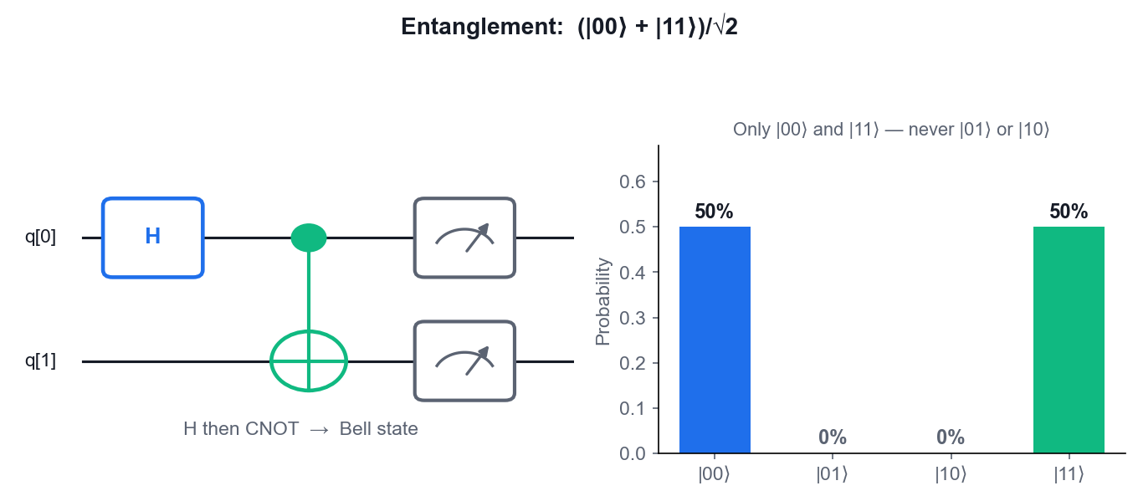
PRINCIPLE 2
Quantum Entanglement
Linked states
Two or more particles whose quantum states cannot be described independently.
Instant correlation
Measuring one instantly determines the other, at any distance.
EPR paradox
Einstein, Podolsky and Rosen called it 'spooky action at a distance' and thought QM incomplete.
Bell's answer
Bell inequalities — and the CHSH experiment — showed nature really is non-local.
The Bell state (|00> + |11>)/sqrt(2) — never |01> or |10>.
Quantum Computing Fundamentals for Beginners · C882
© 2026 Tertiary Infotech Academy Pte Ltd
17

Slide 19
THE SEPARABILITY CONDITION
Separability — Is a State Entangled?
Product state
If |psi> can be written as |a> tensor |b>, the two qubits are INDEPENDENT — not entangled.
The test
For a|00> + b|01> + c|10> + d|11>, the state is separable if and only if ad = bc.
1
2
Worked example
The Bell state has a = d = 1/sqrt(2) and b = c = 0, so ad = 1/2 but bc = 0. They differ — it IS entangled.
Counter-example
(|00> + |01>)/sqrt(2) gives ad = 0 and bc = 0. Equal — so it is NOT entangled; it is just |0> tensor |+>.
3
4
Quantum Computing Fundamentals for Beginners · C882
© 2026 Tertiary Infotech Academy Pte Ltd
18

Slide 20
THE RULES OF THE GAME
The Five Postulates of Quantum Mechanics
1 · State space
A closed quantum system is described by a unit vector in a complex Hilbert space.
2 · Time evolution
A closed system evolves by a UNITARY operator: |psi'> = U|psi>. Every quantum gate is unitary, hence reversible.
1
2
3 · Observables
Every measurable quantity is a Hermitian operator; its eigenvalues are the possible results.
4 · Born rule
The probability of outcome m is |<m|psi>|^2 — the squared amplitude.
3
4
5 · Collapse
After measuring m, the state becomes |m>. The superposition is destroyed.
Grouping
Postulates 1–2 describe state and deterministic evolution; 3–5 describe measurement.
5
6
Quantum Computing Fundamentals for Beginners · C882
© 2026 Tertiary Infotech Academy Pte Ltd
19

Slide 21
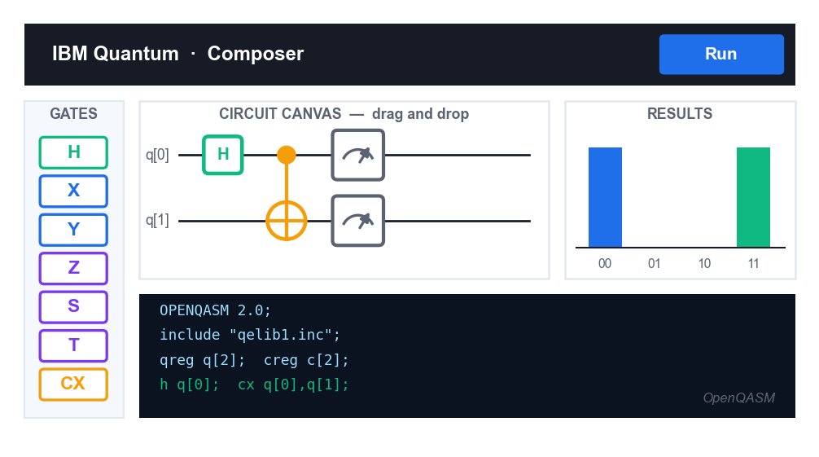
TOPIC 01 · PLATFORMS
Quantum Computing Platforms
https://quantum.cloud.ibm.com/composer
1
IBM Quantum Composer — drag-and-drop circuits, simulator and real hardware. Our main tool.
2
IBM Quantum Platform — job queue, backends and calibration data.
3
Quirk (algassert.com/quirk) — instant in-browser statevector visualisation.
4
Quantum Circuit Designer — thequantumlaend.de, good for larger Grover circuits.
5
Qiskit and PennyLane — Python SDKs for coding circuits programmatically.
Every lab in this course runs on IBM Quantum Composer — no installation, no cost, works in any browser.
Quantum Computing Fundamentals for Beginners · C882
© 2026 Tertiary Infotech Academy Pte Ltd
20

Slide 22
WHY INDUSTRY CARES
Use Cases of Quantum Computing
Chemistry & pharma
Simulate molecules exactly — drug discovery, catalysts, nitrogen fixation.
Finance
Portfolio optimisation, derivative pricing and risk analysis by quantum Monte Carlo.
Logistics
Route and fleet optimisation, scheduling and supply-chain planning (QAOA).
1
2
3
Materials science
Design superconductors, batteries and novel materials from first principles.
Cryptography
Shor's algorithm threatens RSA/ECC; QKD offers physics-based key exchange.
Machine learning
Quantum kernels, variational classifiers and quantum-enhanced optimisation.
4
5
6
Quantum Computing Fundamentals for Beginners · C882
© 2026 Tertiary Infotech Academy Pte Ltd
21

Slide 23
WHAT YOU'LL DO ON IBM QUANTUM COMPOSER
Hands-On Labs — Introduction to Quantum Computing
Lab 1
Lab 2
Lab 3
• Explore the Qubit on the Bloch Sphere
• Observe Superposition and Interference
• Create Your First Entangled Pair (Bell State)
Quantum Computing Fundamentals for Beginners · C882
© 2026 Tertiary Infotech Academy Pte Ltd
22

Slide 24
TOPIC 01 · HANDS-ON
Explore the Qubit on the Bloch Sphere
LAB 1
Bloch Sphere Simulator
Use an interactive Bloch-sphere simulator to see what a qubit actually is: a point on a sphere. Apply X, H and Z and watch the state vector move, so that every gate you meet later has a picture attached to it.
1
2
3
4
5
▶
▶
▶
▶
Open the Bloch sphere simulator and identify the three…
Confirm the qubit starts at the north pole — the state…
Apply the X gate
Reset, then apply H
With the state at |+>, apply Z
YOU'LL PRODUCE A worked set of Bloch-sphere states (|0>, |1>, |+>, |->) and the gates that produce them.
Full step-by-step guide: Learner Guide, Lab 1
Quantum Computing Fundamentals for Beginners · C882
© 2026 Tertiary Infotech Academy Pte Ltd
23

Slide 25
TOPIC 01 · HANDS-ON
Observe Superposition and Interference
LAB 2
IBM Quantum Composer
Build the smallest possible quantum circuit — a single Hadamard gate — on IBM Quantum Composer, run it on the simulator, and read the probability histogram. Then add a second Hadamard to see interference cancel the superposition completely.
1
2
3
4
5
▶
▶
▶
▶
Sign in to IBM Quantum and open the Composer from the…
Create a new circuit and set the circuit width to 1 qubit…
Drag an H gate onto qubit q[0], then drag a Measure…
Open the OpenQASM editor and confirm the code reads: h…
Run the circuit on the simulator with 1024 shots and read…
YOU'LL PRODUCE Two single-qubit circuits: H (a 50/50 random bit) and H-H (a deterministic 0), with their histograms.
Full step-by-step guide: Learner Guide, Lab 2
Quantum Computing Fundamentals for Beginners · C882
© 2026 Tertiary Infotech Academy Pte Ltd
24

Slide 26
TOPIC 01 · HANDS-ON
Create Your First Entangled Pair (Bell State)
LAB 3
IBM Quantum Composer
Build the Bell state (|00> + |11>)/sqrt(2) on IBM Quantum Composer with just H and CNOT, and confirm from the histogram that the two qubits are perfectly correlated — the signature of entanglement.
1
2
3
4
5
▶
▶
▶
▶
Open a new circuit in IBM Quantum Composer with 2 qubits…
Place an H gate on q[0]
Place a CNOT with the control on q[0] and the target on…
Add Measure operations on both q[0] and q[1]
Inspect the statevector panel: the amplitudes are…
YOU'LL PRODUCE A 2-qubit Bell-state circuit whose histogram shows only |00> and |11>, each near 50%.
Full step-by-step guide: Learner Guide, Lab 3
Quantum Computing Fundamentals for Beginners · C882
© 2026 Tertiary Infotech Academy Pte Ltd
25

Slide 27
Lunch Break
30 minutes

Slide 28
TOPIC 01 RECAP
Recap — Introduction to Quantum Computing
• A qubit is a superposition of |0> and |1>, drawn as a point on the Bloch sphere.
• Superposition plus interference is what makes quantum algorithms faster — not randomness alone.
• Entanglement links qubits so that measuring one determines the other; test separability with ad = bc.
• Any two-level quantum system works as a qubit — superconducting, trapped ion, photonic or topological.
• IBM Quantum Composer gives you a free simulator and real hardware in the browser.
Quantum Computing Fundamentals for Beginners · C882
© 2026 Tertiary Infotech Academy Pte Ltd
27

Slide 29
02
TOPIC 02
Quantum States and Gates
Quantum State Vector Representations · Quantum Circuits and Quantum Gates
Quantum Computing Fundamentals for Beginners · C882
© 2026 Tertiary Infotech Academy Pte Ltd
28

Slide 30
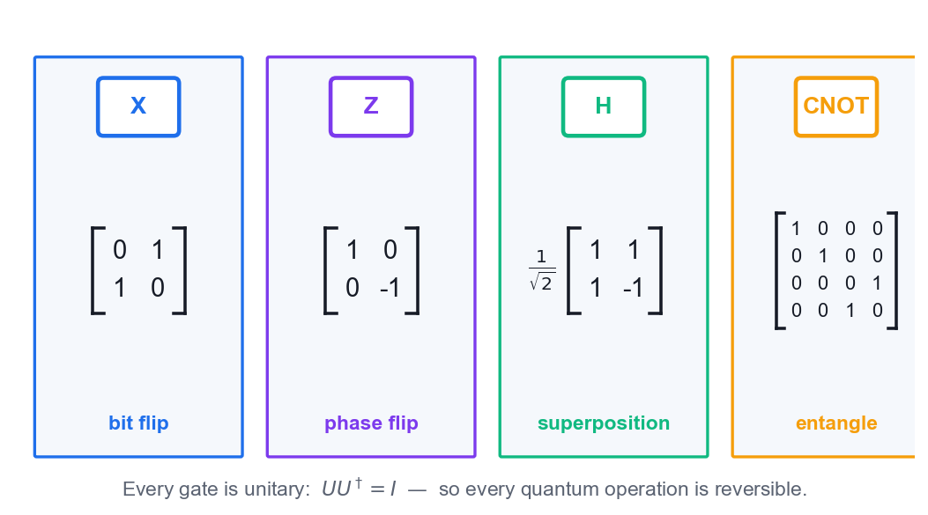
TOPIC 02 · THE ALGEBRA
Quantum Gates Are Unitary Matrices
Unitary
U times U-dagger = I. Every gate is reversible — no information is ever destroyed.
Acting on a vector
A gate multiplies the state vector: |psi'> = U|psi>.
Single vs multi-qubit
1-qubit gates are 2x2; 2-qubit gates are 4x4; an n-qubit gate is 2^n x 2^n.
Universality
A small gate set (e.g. H, T and CNOT) can approximate ANY quantum computation.
Gates rotate the state vector on the Bloch sphere.
Quantum Computing Fundamentals for Beginners · C882
© 2026 Tertiary Infotech Academy Pte Ltd
29

Slide 31
THE THREE PAULI GATES
The Pauli Gates — X, Y and Z
Pauli X · NOT
Pauli Y
Pauli Z · phase flip
X = [[0, 1],
[1, 0]]
X|0> = |1>
X|1> = |0>
Y = [[0, -i],
[i, 0]]
Y|0> = i|1>
Z = [[1, 0],
[0, -1]]
Z|+> = |->
A 180-degree rotation about the X axis. The quantum NOT gate — it flips the bit.
A 180-degree rotation about the Y axis. Combines a bit flip and a phase flip (Y = iXZ).
A 180-degree rotation about the Z axis. Leaves |0> alone and negates |1> — invisible to measurement alone.
Quantum Computing Fundamentals for Beginners · C882
© 2026 Tertiary Infotech Academy Pte Ltd
30

Slide 32
WHAT TO REMEMBER
Key Properties of the Pauli Gates
Self-inverse
X.X = Y.Y = Z.Z = I — apply any Pauli twice and you are back where you started.
Hermitian and unitary
Each Pauli is its own conjugate transpose AND its own inverse.
1
2
Anticommuting
XY = -YX, YZ = -ZY, ZX = -XZ. Order matters, and swapping it costs a minus sign.
Eigenvalues
Every Pauli has eigenvalues +1 and -1 — the two possible measurement outcomes.
3
4
Z eigenstates
|0> and |1> — the computational basis.
X eigenstates
|+> and |-> — the Hadamard basis, used by BB84.
5
6
Quantum Computing Fundamentals for Beginners · C882
© 2026 Tertiary Infotech Academy Pte Ltd
31

Slide 33
THE WORKHORSE GATE
The Hadamard Gate — Making Superposition
The matrix
Its action
On n qubits
H = (1/sqrt(2)) x
[[1, 1],
[1, -1]]
H|0> = |+>
H|1> = |->
H|+> = |0>
H on every qubit gives
(1/sqrt(2^n)) sum over all x
of |x>
The single most important gate. It maps the computational basis to the superposition basis.
Creates an equal superposition from a basis state, and converts it back. H is its own inverse: H.H = I.
One layer of Hadamards puts the register into a uniform superposition over ALL 2^n inputs — the first step of Deutsch-Jozsa, BV and Grover.
Quantum Computing Fundamentals for Beginners · C882
© 2026 Tertiary Infotech Academy Pte Ltd
32

Slide 34
PARAMETERISED GATES
Rotation and Phase Gates
RX, RY, RZ
Phase gate P
S and T
RY(theta) =
[[cos(t/2), -sin(t/2)],
[sin(t/2), cos(t/2)]]
P(phi) = [[1, 0],
[0, e^(i.phi)]]
S = P(pi/2)
T = P(pi/4)
S = T.T
Continuous rotations about the X, Y and Z axes by a free parameter theta. These are the TRAINABLE gates in quantum machine learning.
Applies a relative phase to the |1> component only. Leaves measurement probabilities unchanged in the Z basis.
The two standard fixed phase gates. T is the gate that lifts Clifford circuits to universal quantum computation — and the most expensive to make fault-tolerant.
Quantum Computing Fundamentals for Beginners · C882
© 2026 Tertiary Infotech Academy Pte Ltd
33

Slide 35
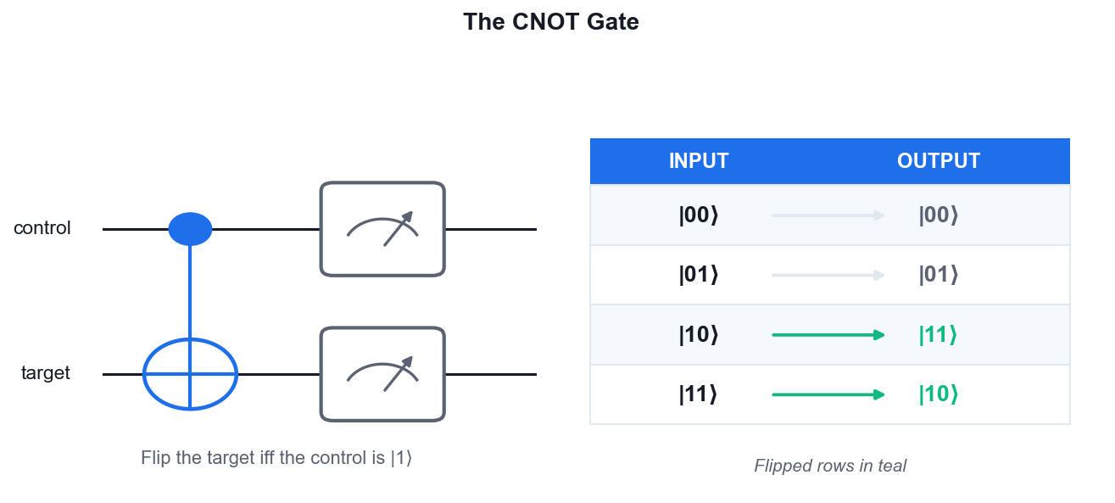
THE ENTANGLING GATE
Two-Qubit Gates — CNOT
The rule
Flip the target if and only if the control is |1>.
Truth table
|00> to |00>, |01> to |01>, |10> to |11>, |11> to |10>.
It entangles
CNOT applied to a superposed control produces a Bell state — no single-qubit gate can do that.
Universality
CNOT plus arbitrary single-qubit rotations is a universal gate set.
H on the control, then CNOT — the two-gate recipe for a Bell pair.
Quantum Computing Fundamentals for Beginners · C882
© 2026 Tertiary Infotech Academy Pte Ltd
34

Slide 36
TOPIC 02 · QUICK REFERENCE
Multi-Qubit Gate Reference
Gate
Qubits
Action
Key use
CNOT (CX)
2
Flips the target when the control is |1>
Entangling; Bell states; oracles
CZ
2
Applies a -1 phase to |11> only
Grover oracle; phase kickback
Controlled-P
2
Applies e^(i.phi) to |11>
Quantum Fourier Transform
SWAP
2
Exchanges the states of two qubits
Routing on real hardware
Toffoli (CCX)
3
Flips the target if BOTH controls are |1>
Reversible classical logic; arithmetic
CCZ
3
Phase-flips |111>
3-qubit Grover oracle
Quantum Computing Fundamentals for Beginners · C882
© 2026 Tertiary Infotech Academy Pte Ltd
35

Slide 37
WHAT TO REMEMBER
Key Properties — CZ, SWAP and Toffoli
CZ is symmetric
Control and target are interchangeable — CZ(a,b) = CZ(b,a). Unusual for a controlled gate.
CZ from CNOT
H on the target, then CNOT, then H on the target, gives exactly CZ. And vice versa.
1
2
SWAP = 3 CNOTs
SWAP is built from three alternating CNOTs — which is why it is expensive on real hardware.
Toffoli is universal
CCNOT alone is universal for REVERSIBLE CLASSICAL computation — it can build AND, NOT and FANOUT.
3
4
Toffoli is expensive
Decomposing one Toffoli needs about six CNOTs plus T gates — a major cost in fault-tolerant design.
All are self-inverse
Applying CZ, SWAP or Toffoli twice returns the original state.
5
6
Quantum Computing Fundamentals for Beginners · C882
© 2026 Tertiary Infotech Academy Pte Ltd
36

Slide 38
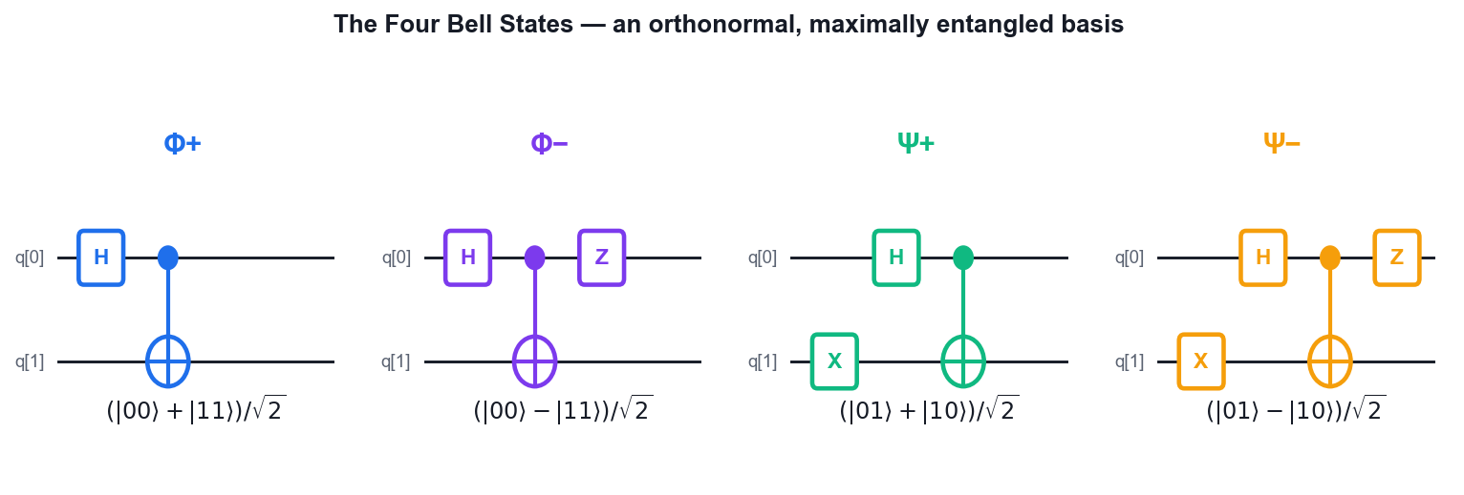
THE FOUR BELL STATES
Bell States — Maximal Entanglement
Phi+
(|00> + |11>)/sqrt(2) — H on q0, then CNOT.
Phi-
(|00> - |11>)/sqrt(2) — add Z after the CNOT.
Psi+
(|01> + |10>)/sqrt(2) — add X on q1 before the CNOT.
Psi-
(|01> - |10>)/sqrt(2) — add both X and Z. The four form an orthonormal basis.
Each Bell state is maximally entangled and mutually orthogonal.
Quantum Computing Fundamentals for Beginners · C882
© 2026 Tertiary Infotech Academy Pte Ltd
37

Slide 39
BEYOND TWO QUBITS
GHZ States — Entangling n Qubits
The state
(|000> + |111>)/sqrt(2) — all three qubits perfectly correlated.
The recipe
One H on the first qubit, then a CNOT from it to every other qubit.
1
2
Generalises
For n qubits: (|0...0> + |1...1>)/sqrt(2), built with one H and n-1 CNOTs.
Fragile
Measuring or losing ANY single qubit destroys the entanglement of the whole state.
3
4
Uses
Multi-party QKD, quantum secret sharing, and benchmarking a device's entangling quality.
Test of QM
GHZ gives a non-statistical contradiction with local realism — stronger than Bell's.
5
6
Quantum Computing Fundamentals for Beginners · C882
© 2026 Tertiary Infotech Academy Pte Ltd
38

Slide 40
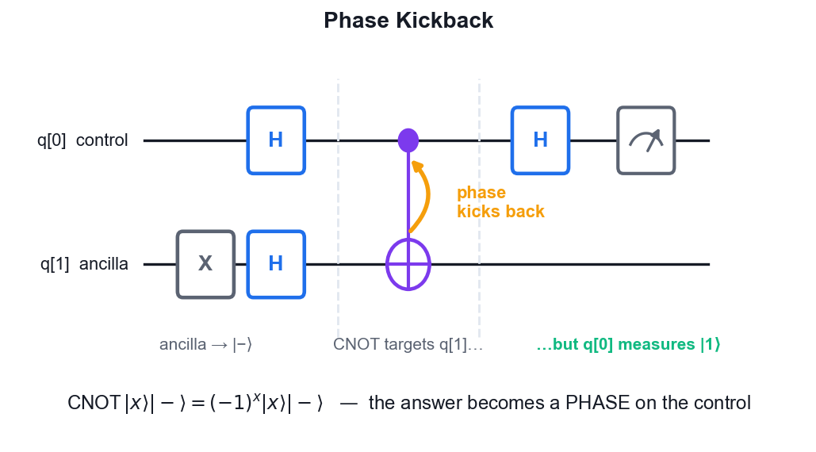
THE ENGINE OF QUANTUM ALGORITHMS
Phase Kickback
The mechanism
A phase applied to the TARGET of a controlled gate appears on the CONTROL instead.
Why
If the target is an eigenstate of the operation, the controlled gate can only contribute a global-to-relative phase on the control.
The |-> trick
Put the ancilla in |-> and a CNOT applies a -1 phase exactly when the control is |1>.
Where it is used
Deutsch, Deutsch-Jozsa, Bernstein-Vazirani, Grover's oracle and Quantum Phase Estimation.
Phase kickback converts an oracle's answer into a measurable phase.
Quantum Computing Fundamentals for Beginners · C882
© 2026 Tertiary Infotech Academy Pte Ltd
39

Slide 41
WHAT YOU'LL DO ON IBM QUANTUM COMPOSER
Hands-On Labs — Quantum States and Gates
Lab 4–5
Lab 6–7
—
• Single-Qubit Gates — Pauli X, Y, Z and Hadamard
• Rotation and Phase Gates — RX, RY, RZ, S and T
• Two-Qubit Gates — CNOT, CZ, SWAP and Toffoli
• Bell States, GHZ States and Phase Kickback
• —
Quantum Computing Fundamentals for Beginners · C882
© 2026 Tertiary Infotech Academy Pte Ltd
40

Slide 42
TOPIC 02 · HANDS-ON
Single-Qubit Gates — Pauli X, Y, Z and Hadamard
LAB 4
IBM Quantum Composer
Work through the single-qubit gate set on IBM Quantum Composer. Apply each Pauli gate and the Hadamard to |0> and to |1>, read the resulting statevector, and verify from the simulator that each Pauli gate is its own inverse.
1
2
3
4
5
▶
▶
▶
▶
Open a 1-qubit circuit in IBM Quantum Composer and keep…
Apply X to q[0] and confirm the state becomes |1> — X is…
Clear, apply Z to q[0], and confirm the state stays |0>
Build H then Z
Apply Y to |0> and read the statevector: you get i|1>
YOU'LL PRODUCE A gate reference table you fill in yourself: the output state and measurement probabilities for X, Y, Z and H on |0> and |1>.
Full step-by-step guide: Learner Guide, Lab 4
Quantum Computing Fundamentals for Beginners · C882
© 2026 Tertiary Infotech Academy Pte Ltd
41

Slide 43
TOPIC 02 · HANDS-ON
Rotation and Phase Gates — RX, RY, RZ, S and T
LAB 5
IBM Quantum Composer
Move beyond fixed gates to parameterised rotations. Sweep the angle of an RY gate on IBM Quantum Composer and watch the measurement probability change continuously — the basis of every variational quantum algorithm.
1
2
3
4
5
▶
▶
▶
▶
Open a 1-qubit circuit with a Measure and place an RY…
Set theta = pi/2 and run 1024 shots
Set theta = pi and run again
Set theta = pi/4 and predict the split BEFORE running…
Replace RY with RX(pi) and confirm it also produces |1> —…
YOU'LL PRODUCE A probability-vs-angle table for RY(theta) at theta = 0, pi/4, pi/2, 3pi/4 and pi, plus the S and T phase gates demonstrated.
Full step-by-step guide: Learner Guide, Lab 5
Quantum Computing Fundamentals for Beginners · C882
© 2026 Tertiary Infotech Academy Pte Ltd
42

Slide 44
TOPIC 02 · HANDS-ON
Two-Qubit Gates — CNOT, CZ, SWAP and Toffoli
LAB 6
IBM Quantum Composer
Build the truth table of the multi-qubit gates by hand on IBM Quantum Composer. Prepare each computational basis input with X gates, apply the gate, and read off the output — the fastest way to make CNOT, CZ, SWAP and Toffoli concrete.
1
2
3
4
5
▶
▶
▶
▶
Open a 2-qubit circuit
Measure both qubits and run
Repeat for input |00> (no X gates)
Replace the CNOT with a CZ gate on input |11> (X on both…
Make the CZ phase visible: build H on q[1], then CZ, then…
YOU'LL PRODUCE Completed truth tables for CNOT, SWAP and Toffoli, plus a demonstration that CZ only applies a phase.
Full step-by-step guide: Learner Guide, Lab 6
Quantum Computing Fundamentals for Beginners · C882
© 2026 Tertiary Infotech Academy Pte Ltd
43

Slide 45
TOPIC 02 · HANDS-ON
Bell States, GHZ States and Phase Kickback
LAB 7
IBM Quantum Composer
Build all four Bell states and the 3-qubit GHZ state on IBM Quantum Composer, then demonstrate phase kickback — the mechanism that makes the Deutsch, Bernstein-Vazirani and phase-estimation algorithms work.
1
2
3
4
5
▶
▶
▶
▶
Build the Phi+ Bell state with H on q[0] then CNOT(q[0]…
Add an X on q[1] before the CNOT to build Psi+ = (|01> +…
Add a Z on q[0] after the CNOT to build Phi- = (|00> -…
Extend to three qubits: H on q[0], CNOT(q[0], q[1])…
Run the GHZ circuit for 1024 shots and confirm only |000>…
YOU'LL PRODUCE The four Bell states, a GHZ state, and a phase-kickback circuit showing the phase moving onto the control qubit.
Full step-by-step guide: Learner Guide, Lab 7
Quantum Computing Fundamentals for Beginners · C882
© 2026 Tertiary Infotech Academy Pte Ltd
44

Slide 46
TOPIC 02 RECAP · END OF DAY 1
Recap — Quantum States and Gates
• Every gate is a unitary matrix, so every quantum operation is reversible.
• X, Y and Z are the Pauli gates — self-inverse, anticommuting, with eigenvalues +1 and -1.
• H creates superposition; RX/RY/RZ rotate by a free angle; S and T apply fixed phases.
• CNOT entangles; CZ phase-flips |11>; SWAP exchanges; Toffoli is reversible classical logic.
• H then CNOT builds a Bell pair. Phase kickback is what makes the query algorithms work.
Quantum Computing Fundamentals for Beginners · C882
© 2026 Tertiary Infotech Academy Pte Ltd
45

Slide 47
03
TOPIC 03
Quantum Algorithms
Coding Quantum Algorithms · Testing Quantum Algorithms
Quantum Computing Fundamentals for Beginners · C882
© 2026 Tertiary Infotech Academy Pte Ltd
46

Slide 48
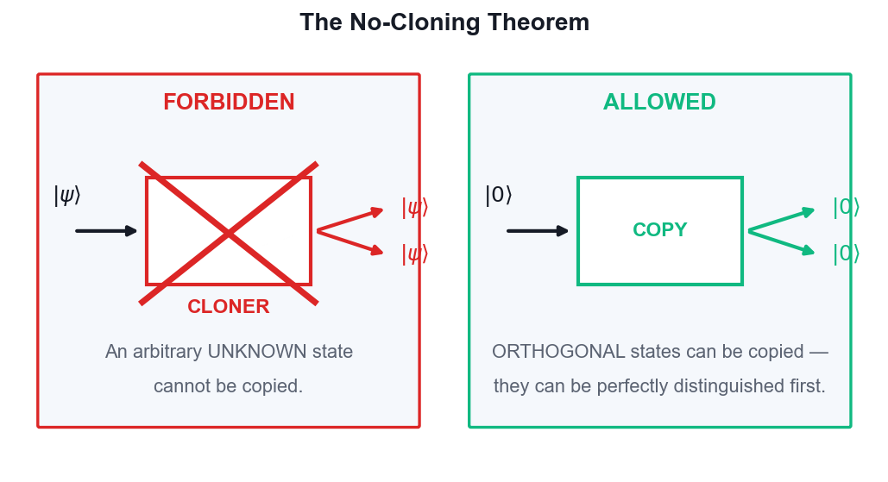
TOPIC 03 · THE FOUNDATION OF QUANTUM SECURITY
The No-Cloning Theorem
The statement
It is impossible to build a machine that copies an arbitrary UNKNOWN quantum state.
The proof
Linearity of quantum mechanics forbids it — assume a cloner exists and you derive a contradiction.
The exception
Orthogonal states CAN be copied, because they can be perfectly distinguished first.
The consequence
Quantum information cannot be broadcast or backed up — and eavesdroppers cannot copy a key.
No-cloning is why QKD is secure and why teleportation must destroy the original.
Quantum Computing Fundamentals for Beginners · C882
© 2026 Tertiary Infotech Academy Pte Ltd
47

Slide 49
MOVING A QUBIT WITHOUT MOVING A QUBIT
Quantum Teleportation — The Protocol
1
2
3
4
5
▶
▶
▶
▶
Alice and Bob share an entangled Bell pair in advance
Alice holds the unknown qubit she wants to send
Alice performs a Bell measurement on her two qubits
Alice sends the two classical bits to Bob
Bob applies X and/or Z to recover the exact state
Quantum Computing Fundamentals for Beginners · C882
© 2026 Tertiary Infotech Academy Pte Ltd
48

Slide 50
COMMON MISCONCEPTIONS
Quantum Teleportation — What It Is and Is Not
The problem
Alice must send an unknown qubit to Bob but can transmit only classical information.
The resources
One shared Bell pair plus exactly two classical bits per qubit teleported.
1
2
No faster than light
Bob's qubit is useless until Alice's two classical bits arrive — causality is safe.
The original dies
Alice's measurement destroys her copy — exactly as no-cloning requires.
3
4
Not matter transport
Nothing physical travels; only the STATE is transferred onto Bob's existing qubit.
Why it matters
Teleportation underpins quantum repeaters, quantum networks and fault-tolerant gate design.
5
6
Quantum Computing Fundamentals for Beginners · C882
© 2026 Tertiary Infotech Academy Pte Ltd
49

Slide 51
TWO CLASSICAL BITS FROM ONE QUBIT
Superdense Coding — The Mirror Image
1
2
3
4
5
▶
▶
▶
▶
Alice and Bob share an entangled Bell pair in advance
Alice picks her 2-bit message: 00, 01, 10 or 11
Alice applies I, X, Z or ZX to HER qubit only
Alice sends that single qubit to Bob
Bob applies CNOT then H and reads both bits
Quantum Computing Fundamentals for Beginners · C882
© 2026 Tertiary Infotech Academy Pte Ltd
50

Slide 52
TWO SIDES OF ONE COIN
Teleportation vs Superdense Coding
Qubit over classical channel
Bits over quantum channel
• Quantum teleportation
– Sends: one QUBIT (unknown state)
– Consumes: 1 Bell pair + 2 classical bits
– Alice measures; Bob corrects
– Use: quantum networks, repeaters
– Original is destroyed (no-cloning)
• Superdense coding
– Sends: two CLASSICAL BITS
– Consumes: 1 Bell pair + 1 qubit sent
– Alice encodes; Bob decodes
– Use: doubling channel capacity
– Beats Holevo's bound only via prior entanglement
Quantum Computing Fundamentals for Beginners · C882
© 2026 Tertiary Infotech Academy Pte Ltd
51

Slide 53
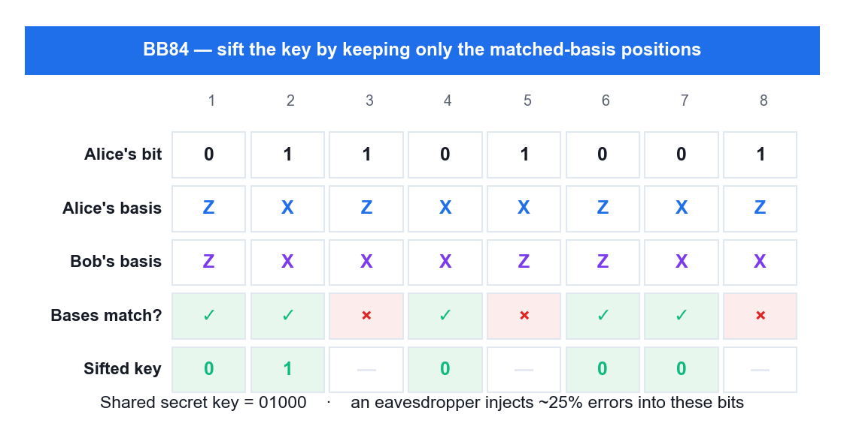
TOPIC 03 · SECURE KEY EXCHANGE
BB84 — Quantum Key Distribution
Bennett & Brassard, 1984
The first and most famous QKD protocol — provably secure by physics, not by hardness.
Two bases
Alice encodes each bit in the Z basis (|0>, |1>) or the X basis (|+>, |->), chosen at random.
Sifting
Alice and Bob publicly compare BASES (never bits) and keep only the matched positions.
Eve is caught
Measuring in the wrong basis disturbs the state, injecting about a 25% error rate in the sifted key.
Security rests on no-cloning and measurement disturbance — not on computational difficulty.
Quantum Computing Fundamentals for Beginners · C882
© 2026 Tertiary Infotech Academy Pte Ltd
52

Slide 54
HOW THE KEY IS AGREED
The BB84 Protocol Step by Step
1
2
3
4
5
▶
▶
▶
▶
Alice picks a random bit and a random basis for each qubit
Alice sends the encoded qubits over the quantum channel
Bob measures each qubit in his own randomly chosen basis
They publicly compare bases and discard the mismatches
They sacrifice some bits to check the error rate for Eve
Quantum Computing Fundamentals for Beginners · C882
© 2026 Tertiary Infotech Academy Pte Ltd
53

Slide 55
HOW WE MEASURE QUANTUM ADVANTAGE
The Query (Oracle) Model
The setup
An unknown function f is hidden inside a black box. You may only ASK it about inputs.
The measure
Count the QUERIES, not the gates. This isolates true quantum advantage from implementation detail.
1
2
The quantum oracle
A unitary U_f that maps |x>|y> to |x>|y XOR f(x)> — reversible, as every gate must be.
Why XOR
Writing the answer into a second register keeps the oracle reversible and enables phase kickback.
3
4
Superposition query
One query on a superposed input evaluates f on ALL inputs at once.
The catch
Measurement returns only ONE answer — the algorithm must use interference to extract a GLOBAL property.
5
6
Quantum Computing Fundamentals for Beginners · C882
© 2026 Tertiary Infotech Academy Pte Ltd
54

Slide 56
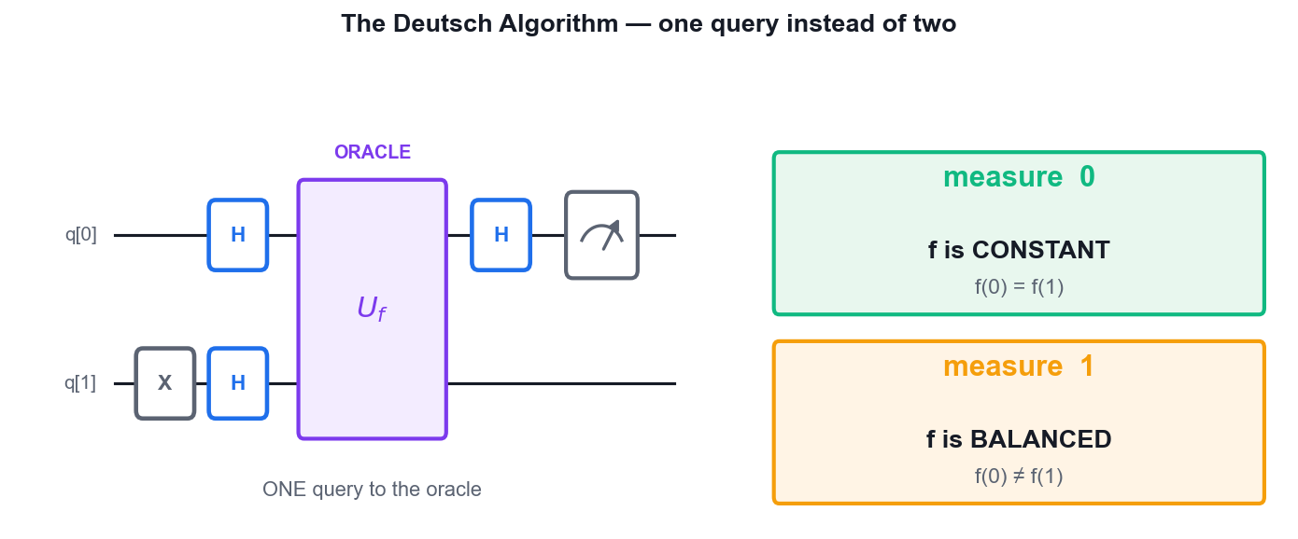
THE FIRST QUANTUM SPEEDUP
The Deutsch Algorithm
The question
Is f: {0,1} to {0,1} CONSTANT (same output) or BALANCED (different outputs)?
Classically
You must evaluate f twice — f(0) and f(1) — and compare them.
Quantum
ONE query. Measure the control: 0 means constant, 1 means balanced.
The mechanism
Phase kickback writes f(0) XOR f(1) into the control's phase; the final H turns it into a bit.
Two classical queries become one quantum query.
Quantum Computing Fundamentals for Beginners · C882
© 2026 Tertiary Infotech Academy Pte Ltd
55

Slide 57
EXPONENTIAL ADVANTAGE · DETERMINISTIC
Deutsch-Jozsa — The Full Speedup
Classical (worst case)
Quantum (Deutsch-Jozsa)
Queries needed
2^(n-1) + 1
1
n = 3
5 queries
1 query
n = 10
513 queries
1 query
n = 20
524,289 queries
1 query
Certainty
Deterministic
Deterministic
Reading the result
Compare outputs
All zeros = constant; anything else = balanced
Quantum Computing Fundamentals for Beginners · C882
© 2026 Tertiary Infotech Academy Pte Ltd
56

Slide 58
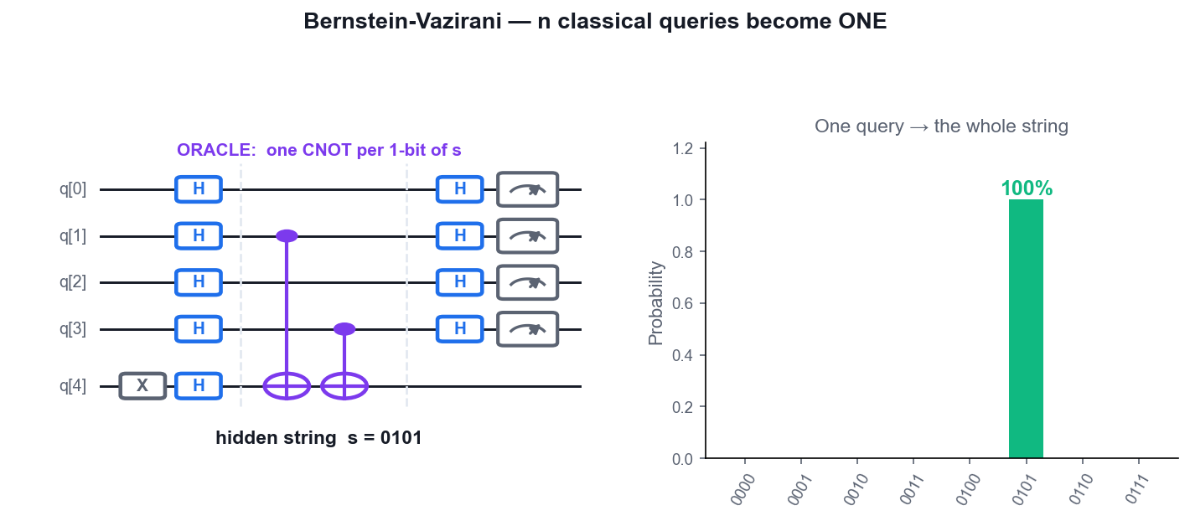
n QUERIES BECOME ONE
The Bernstein-Vazirani Algorithm
The problem
f(x) = s.x mod 2 for a hidden n-bit string s. Find s.
Classically
n queries — probe one bit at a time with 100...0, 010...0 and so on.
Quantum
ONE query recovers all n bits of s simultaneously.
The oracle
One CNOT from each input qubit where s has a 1, onto the |-> ancilla.
The hidden string appears directly in the measurement histogram.
Quantum Computing Fundamentals for Beginners · C882
© 2026 Tertiary Infotech Academy Pte Ltd
57

Slide 59
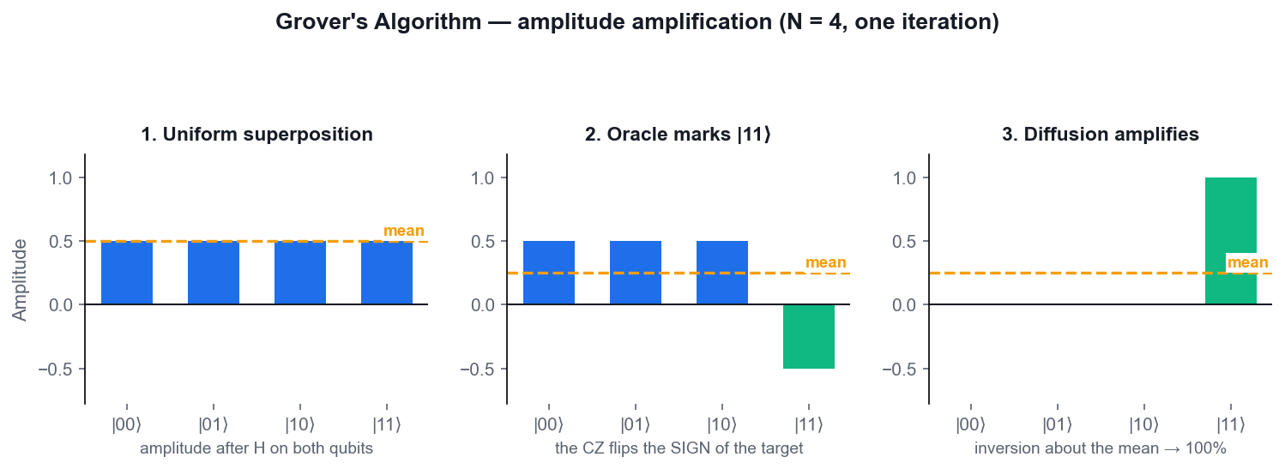
TOPIC 03 · UNSTRUCTURED SEARCH
Grover's Search Algorithm
The problem
Find the one marked item among N unsorted items.
Classically
N/2 look-ups on average; N in the worst case.
Quantum
About (pi/4).sqrt(N) iterations — a QUADRATIC speedup.
Two parts
An ORACLE that phase-flips the target, then a DIFFUSION operator that inverts about the mean.
Amplitude amplification: each iteration rotates the state toward the marked item.
Quantum Computing Fundamentals for Beginners · C882
© 2026 Tertiary Infotech Academy Pte Ltd
58

Slide 60
AMPLITUDE AMPLIFICATION
Grover's Algorithm — The Loop
1
2
3
4
5
▶
▶
▶
▶
Apply H to every qubit for a uniform superposition
ORACLE: phase-flip the marked state (e.g. CZ marks |11>)
DIFFUSION: H, X, CZ, X, H — invert about the mean
Repeat the oracle + diffusion about sqrt(N) times
Measure — the marked item appears with high probability
Quantum Computing Fundamentals for Beginners · C882
© 2026 Tertiary Infotech Academy Pte Ltd
59

Slide 61
WHAT TO REMEMBER
Grover — Practical Points
Iteration count matters
Use about (pi/4).sqrt(N). For N = 4 that is exactly ONE iteration, giving 100%.
Over-rotation hurts
Run too many iterations and the amplitude rotates PAST the target and back down.
1
2
Quadratic, not exponential
Grover is a square-root speedup — real, but far weaker than Shor's exponential one.
It is provably optimal
No quantum algorithm can search an unstructured space faster than sqrt(N).
3
4
Oracle construction
Mark |01> by putting X gates around the CZ on the qubits that should be 0.
Impact on crypto
Grover halves effective symmetric key strength — AES-128 falls to about 64 bits, so use AES-256.
5
6
Quantum Computing Fundamentals for Beginners · C882
© 2026 Tertiary Infotech Academy Pte Ltd
60

Slide 62
THE BASIS OF SHOR'S ALGORITHM
Quantum Fourier Transform — A Look Ahead
What it is
The quantum analogue of the discrete Fourier transform, acting on amplitudes.
The cost
O(n^2) gates for 2^n amplitudes, versus O(n.2^n) for the classical FFT — exponentially fewer.
1
2
The circuit
Hadamards interleaved with controlled-phase rotations, then a final reversal of qubit order.
Where it is used
Quantum Phase Estimation, and hence Shor's factoring algorithm and the HHL linear solver.
3
4
The catch
The output amplitudes are not directly readable — you must design interference to extract the answer.
Why it matters
QFT is the source of the exponential speedups, whereas Grover's is only quadratic.
5
6
Quantum Computing Fundamentals for Beginners · C882
© 2026 Tertiary Infotech Academy Pte Ltd
61

Slide 63
WHAT YOU'LL DO ON IBM QUANTUM COMPOSER
Hands-On Labs — Quantum Algorithms
Lab 8–9
Lab 10–11
Lab 12–13
• Quantum Teleportation
• Superdense Coding
• BB84 Quantum Key Distribution
• The Deutsch and Deutsch-Jozsa Algorithms
• The Bernstein-Vazirani Algorithm
• Grover's Search Algorithm
Quantum Computing Fundamentals for Beginners · C882
© 2026 Tertiary Infotech Academy Pte Ltd
62

Slide 64
TOPIC 03 · HANDS-ON
Quantum Teleportation
LAB 8
IBM Quantum Composer
Teleport an unknown qubit state from Alice to Bob on IBM Quantum Composer using one shared Bell pair and two classical bits. Build it until you can do it from memory.
1
2
3
4
5
▶
▶
▶
▶
Open a 3-qubit circuit in IBM Quantum Composer
Prepare the state to be teleported
Create the shared Bell pair between Alice and Bob: H on…
Add a barrier, then perform Alice's Bell measurement…
Measure q[0] and q[1] into the classical bits
YOU'LL PRODUCE A 3-qubit teleportation circuit that moves a |+> state from q[0] to q[2] and verifies the transfer.
Full step-by-step guide: Learner Guide, Lab 8
Quantum Computing Fundamentals for Beginners · C882
© 2026 Tertiary Infotech Academy Pte Ltd
63

Slide 65
TOPIC 03 · HANDS-ON
Superdense Coding
LAB 9
IBM Quantum Composer
Run teleportation in reverse: send two classical bits by transmitting one qubit. Encode each of the four messages 00, 01, 10 and 11 on IBM Quantum Composer and confirm Bob decodes each one with certainty.
1
2
3
4
5
▶
▶
▶
▶
Open a 2-qubit circuit
Add a barrier
To send 00, Alice applies nothing (the identity)
Build the decoder that Bob applies: CNOT(q[0], q[1])…
Run the 00 circuit for 1024 shots
YOU'LL PRODUCE Four superdense-coding circuits, one per two-bit message, each decoding deterministically.
Full step-by-step guide: Learner Guide, Lab 9
Quantum Computing Fundamentals for Beginners · C882
© 2026 Tertiary Infotech Academy Pte Ltd
64

Slide 66
TOPIC 03 · HANDS-ON
BB84 Quantum Key Distribution
LAB 10
IBM Quantum Composer
Simulate the BB84 key-exchange protocol on IBM Quantum Composer. Encode bits in randomly chosen bases, measure in randomly chosen bases, sift the key — then introduce an eavesdropper and watch the error rate expose her.
1
2
3
4
5
▶
▶
▶
▶
Understand the encoding: Alice sends bit 0 as |0> or |+>…
On a 1-qubit circuit, prepare bit 1 in the X basis: X…
Bob measures in the X basis by applying H before the…
Now let Bob measure in the WRONG basis: remove his H so…
Repeat for at least 8 qubits with a random basis choice…
YOU'LL PRODUCE A sifted BB84 key produced without eavesdropping, and the elevated error rate produced when Eve intercepts.
Full step-by-step guide: Learner Guide, Lab 10
Quantum Computing Fundamentals for Beginners · C882
© 2026 Tertiary Infotech Academy Pte Ltd
65

Slide 67
TOPIC 03 · HANDS-ON
The Deutsch and Deutsch-Jozsa Algorithms
LAB 11
IBM Quantum Composer
Build the first algorithm that beats every classical method. Determine whether a black-box function is constant or balanced using a single query on IBM Quantum Composer, then scale it up to the multi-qubit Deutsch-Jozsa version.
1
2
3
4
5
▶
▶
▶
▶
Open a 2-qubit circuit
Add a barrier, then build the BALANCED oracle f(x) = x as…
Add a barrier, apply H to q[0], and measure q[0] only
Run 1024 shots
Replace the oracle with the CONSTANT function f(x) = 0 —…
YOU'LL PRODUCE Four Deutsch circuits (both constant and both balanced oracles) and a 3-qubit Deutsch-Jozsa circuit.
Full step-by-step guide: Learner Guide, Lab 11
Quantum Computing Fundamentals for Beginners · C882
© 2026 Tertiary Infotech Academy Pte Ltd
66

Slide 68
TOPIC 03 · HANDS-ON
The Bernstein-Vazirani Algorithm
LAB 12
IBM Quantum Composer
Recover a hidden 4-bit string in a single query instead of four. Build the circuit for the hidden string 0101 (decimal 5) until it is second nature.
1
2
3
4
5
▶
▶
▶
▶
Open a 5-qubit circuit: q[0]-q[3] are the input register…
Prepare the ancilla in |->: apply X to q[4], then H to…
Apply H to every input qubit q[0], q[1], q[2] and q[3] to…
Add a barrier, then build the oracle for the hidden…
Add a barrier and apply H again to all four input qubits…
YOU'LL PRODUCE A 5-qubit Bernstein-Vazirani circuit that reads out the hidden string 0101 deterministically.
Full step-by-step guide: Learner Guide, Lab 12
Quantum Computing Fundamentals for Beginners · C882
© 2026 Tertiary Infotech Academy Pte Ltd
67

Slide 69
TOPIC 03 · HANDS-ON
Grover's Search Algorithm
LAB 13
IBM Quantum Composer
Build the best-known quantum search algorithm on IBM Quantum Composer. Mark a target item with an oracle, amplify it with the diffusion operator, and find it in O(sqrt(N)) steps.
1
2
3
4
5
▶
▶
▶
▶
Open a 2-qubit circuit with 2 classical bits
Add a barrier, then build the ORACLE that marks |11> with…
Add a barrier, then build the DIFFUSION operator…
Measure both qubits and run 1024 shots
Change the marked item to |01>: put an X on q[0] before…
YOU'LL PRODUCE A 2-qubit Grover circuit that finds the marked item with near-certainty, plus a 3-qubit version.
Full step-by-step guide: Learner Guide, Lab 13
Quantum Computing Fundamentals for Beginners · C882
© 2026 Tertiary Infotech Academy Pte Ltd
68

Slide 70
TOPIC 03 RECAP
Recap — Quantum Algorithms
• No-cloning forbids copying an unknown state — the basis of QKD security.
• Teleportation moves a qubit with one Bell pair and two classical bits; superdense coding is the mirror image.
• BB84 exchanges a provably secure key; an eavesdropper shows up as roughly 25% errors in the sifted key.
• Deutsch, Deutsch-Jozsa and Bernstein-Vazirani all beat classical query counts using phase kickback.
• Grover finds a marked item in about sqrt(N) steps — a quadratic, provably optimal speedup.
Quantum Computing Fundamentals for Beginners · C882
© 2026 Tertiary Infotech Academy Pte Ltd
69

Slide 71
04
TOPIC 04
Quantum Computing Applications
Introduction to Quantum Error Correction · Introduction to Quantum Machine Learning
Quantum Computing Fundamentals for Beginners · C882
© 2026 Tertiary Infotech Academy Pte Ltd
70

Slide 72
TOPIC 04 · THE CENTRAL ENGINEERING PROBLEM
Why Quantum Error Correction?
Qubits are fragile
They decohere in microseconds — heat, vibration and stray fields all destroy the state.
Gates are imperfect
A two-qubit gate error of 1% compounds fast: 100 gates and the answer is noise.
1
2
No copying allowed
No-cloning forbids the classical trick of simply keeping three backup copies.
No peeking allowed
Measuring the data qubit to check it would COLLAPSE the superposition you are protecting.
3
4
The solution
Encode one LOGICAL qubit across many PHYSICAL qubits, and measure only the PARITY.
The prize
Below the error threshold, more qubits make the logical error rate arbitrarily small.
5
6
Quantum Computing Fundamentals for Beginners · C882
© 2026 Tertiary Infotech Academy Pte Ltd
71

Slide 73
THE SAME IDEA, HARDER CONSTRAINTS
Classical vs Quantum Error Correction
Bits
Qubits
• Classical repetition code
– Copy the bit three times: 0 becomes 000
– A flip gives 010 — take the majority vote
– You may freely read and copy bits
– Only ONE error type exists: the bit flip
• Quantum error correction
– Entangle into 3 qubits — you cannot copy
– Measure PARITY via ancillas, never the data
– Reading the data would collapse it
– TWO error types: bit flip (X) and phase flip (Z)
Quantum Computing Fundamentals for Beginners · C882
© 2026 Tertiary Infotech Academy Pte Ltd
72

Slide 74
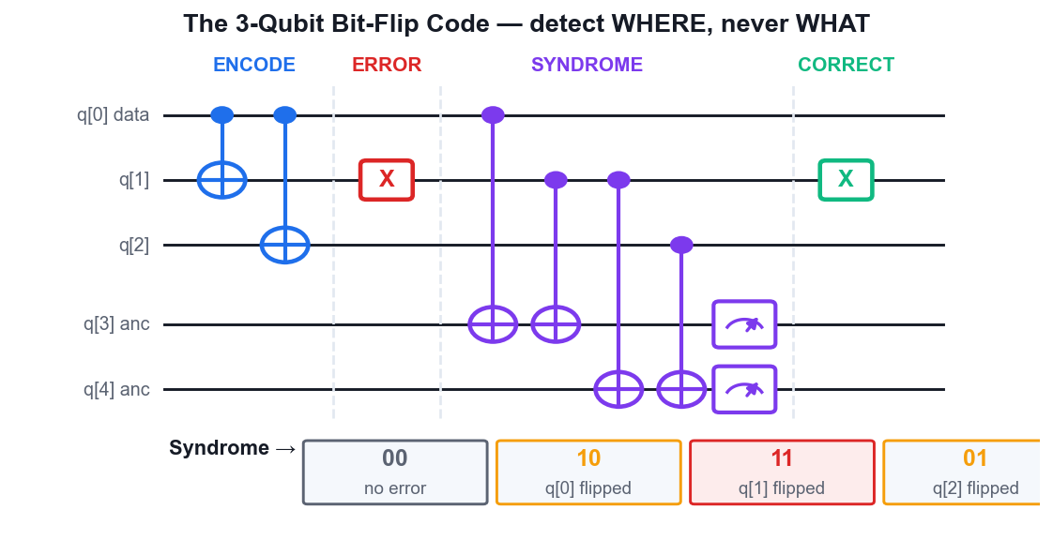
CORRECTING AN X ERROR
The 3-Qubit Bit-Flip Code
Encode
Two CNOTs spread |psi> across three qubits: logical |0> = |000>, logical |1> = |111>.
Error
A stray X flips one qubit — say the middle one, giving |010>.
Syndrome
Two ancillas measure the parities Z0Z1 and Z1Z2 — revealing WHERE, never WHAT.
Correct
Syndrome 11 means qubit 1 flipped; apply X to qubit 1 and the logical state is restored.
Syndrome 00 = no error, 10 = q0, 11 = q1, 01 = q2.
Quantum Computing Fundamentals for Beginners · C882
© 2026 Tertiary Infotech Academy Pte Ltd
73

Slide 75
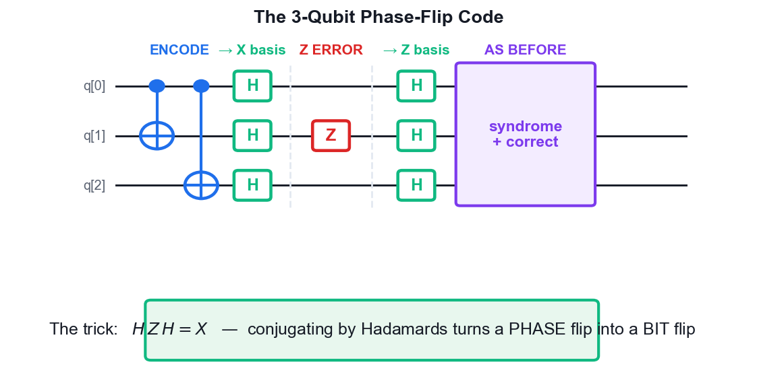
CORRECTING A Z ERROR
The 3-Qubit Phase-Flip Code
The blind spot
A Z error is completely INVISIBLE to the bit-flip code — the syndrome reads 00.
The trick
H Z H = X. Conjugating by Hadamards turns a phase flip into a bit flip.
The code
Encode as before, then apply H to all three qubits — logical states become |+++> and |--->.
Then reuse
Sandwich the bit-flip machinery between Hadamard layers and the same syndrome works.
Every quantum error is a combination of X and Z — correct both and you correct all.
Quantum Computing Fundamentals for Beginners · C882
© 2026 Tertiary Infotech Academy Pte Ltd
74

Slide 76
FROM TOY CODES TO FAULT TOLERANCE
Quantum Error-Correcting Codes
Code
Physical qubits
Corrects
Notes
Bit-flip code
3
One X error
Teaching code; blind to phase errors
Phase-flip code
3
One Z error
The bit-flip code conjugated by Hadamards
Shor code
9
ANY single-qubit error
The first full QEC code (1995); 3 blocks of 3
Steane code
7
ANY single-qubit error
CSS code from the Hamming code; more efficient
Surface code
~1,000 per logical
ANY single-qubit error
2-D lattice, high threshold — the leading candidate
Quantum Computing Fundamentals for Beginners · C882
© 2026 Tertiary Infotech Academy Pte Ltd
75

Slide 77
THE ROAD TO USEFUL QUANTUM COMPUTING
Fault-Tolerant Quantum Computing
The definition
Errors do not spread uncontrollably, and correction is built into EVERY step of the computation.
Logical qubits
One useful qubit encoded in many physical ones — roughly 1,000 to 1 for the surface code.
1
2
Transversal gates
Apply a logical gate as separate physical gates so a single error cannot cascade.
Syndrome measurement
Stabiliser checks detect errors continuously without ever touching the logical state.
3
4
Threshold theorem
Below a physical error rate of about 0.1–1%, arbitrarily long computation becomes possible.
The gap
Useful fault tolerance needs millions of physical qubits — today's machines have hundreds.
5
6
Quantum Computing Fundamentals for Beginners · C882
© 2026 Tertiary Infotech Academy Pte Ltd
76

Slide 78
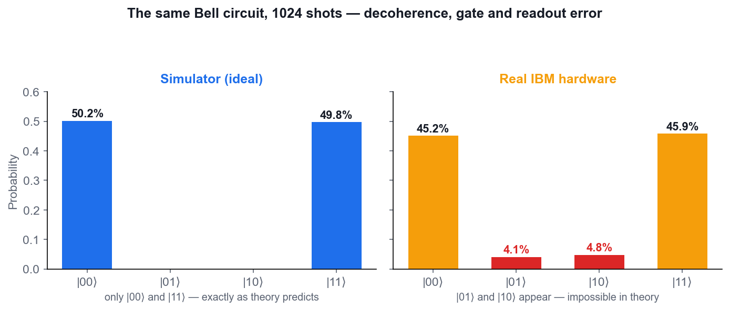
TOPIC 04 · DIAGNOSING UNEXPECTED OUTCOMES
Simulator vs Real Hardware
On the simulator
Perfect qubits, no decoherence, no noise — the Bell state gives ONLY |00> and |11>.
On real hardware
|01> and |10> appear too — outcomes that are theoretically impossible.
The causes
T1 relaxation, T2 dephasing, two-qubit gate infidelity, readout error and crosstalk.
The mitigations
Shallower circuits, better-calibrated qubits, more shots, readout mitigation — then QEC.
This difference is exactly what Lab 16 asks you to explain.
Quantum Computing Fundamentals for Beginners · C882
© 2026 Tertiary Infotech Academy Pte Ltd
77

Slide 79
VARIATIONAL CIRCUITS · THE NISQ WORKHORSE
Introduction to Quantum Machine Learning
The hybrid loop
A quantum circuit computes; a CLASSICAL optimiser updates its parameters. Repeat until converged.
Data encoding
Classical data is loaded as rotation angles (angle encoding) or amplitudes (amplitude encoding).
1
2
The ansatz
A parameterised circuit of trainable RY/RZ rotations interleaved with entangling CNOTs.
Measurement
The expectation value of an observable becomes the model's output, feeding a cost function.
3
4
VQE
Variational Quantum Eigensolver — finds a molecule's ground-state energy. Chemistry's killer app.
QAOA
Quantum Approximate Optimisation Algorithm — tackles combinatorial problems such as MaxCut.
5
6
Quantum Computing Fundamentals for Beginners · C882
© 2026 Tertiary Infotech Academy Pte Ltd
78

Slide 80
HOW A QML MODEL IS TRAINED
The Hybrid Quantum-Classical Training Loop
1
2
3
4
5
▶
▶
▶
▶
Encode the classical input data as rotation angles
Run the parameterised ansatz on the quantum device
Measure to obtain an expectation value
A classical optimiser computes the cost and gradient
Update the parameters and repeat until converged
Quantum Computing Fundamentals for Beginners · C882
© 2026 Tertiary Infotech Academy Pte Ltd
79

Slide 81
CURRENT STATUS AND OUTLOOK
Where We Are Today — The NISQ Era
NISQ
Noisy Intermediate-Scale Quantum: 50–1,000+ qubits, high error rates, short coherence.
Not yet fault-tolerant
IBM, Google and IonQ machines cannot yet run Shor's algorithm at useful scale.
1
2
Already useful
Optimisation pilots, molecular simulation, certified randomness and QKD deployments.
Next 5–10 years
Better qubits, early logical qubits, quantum accelerators alongside GPUs in the cloud.
3
4
The challenges
Scaling to a million qubits, correction overhead, millikelvin cryogenics and control wiring.
Act now
Post-quantum cryptography migration and workforce skills should start today — harvest-now-decrypt-later.
5
6
Quantum Computing Fundamentals for Beginners · C882
© 2026 Tertiary Infotech Academy Pte Ltd
80

Slide 82
WHAT YOU'LL DO ON IBM QUANTUM COMPOSER
Hands-On Labs — Quantum Computing Applications
Lab 14–15
Lab 16–17
—
• Quantum Error Correction — The Bit-Flip Code
• Quantum Error Correction — The Phase-Flip Code
• Simulator vs Real Quantum Hardware
• Introduction to Quantum Machine Learning
• —
Quantum Computing Fundamentals for Beginners · C882
© 2026 Tertiary Infotech Academy Pte Ltd
81

Slide 83
TOPIC 04 · HANDS-ON
Quantum Error Correction — The Bit-Flip Code
LAB 14
IBM Quantum Composer
Protect one logical qubit against a bit-flip error by encoding it into three physical qubits. Deliberately inject an X error on IBM Quantum Composer, detect it with a syndrome measurement, and correct it.
1
2
3
4
5
▶
▶
▶
▶
Open a 5-qubit circuit: q[0]-q[2] hold the encoded…
ENCODE: place the logical state on q[0] (use H for a…
Add a barrier, then INJECT an error: place a single X…
Add a barrier, then measure the first syndrome: CNOT from…
Measure the second syndrome: CNOT from q[1] to q[4] and…
YOU'LL PRODUCE A 3-qubit bit-flip code that detects and corrects an injected X error on any one of the three qubits.
Full step-by-step guide: Learner Guide, Lab 14
Quantum Computing Fundamentals for Beginners · C882
© 2026 Tertiary Infotech Academy Pte Ltd
82

Slide 84
TOPIC 04 · HANDS-ON
Quantum Error Correction — The Phase-Flip Code
LAB 15
IBM Quantum Composer
Phase flips are invisible to the bit-flip code. Learn the standard trick — surround the code with Hadamards to turn Z errors into X errors — and correct a phase flip on IBM Quantum Composer.
1
2
3
4
5
▶
▶
▶
▶
First show the problem: build the bit-flip code from Lab…
Now build the phase-flip code
Add a barrier and INJECT a Z error on q[1] — a phase flip…
Add a barrier, then apply H to all three code qubits again
Run the same syndrome extraction as Lab 14: CNOTs from…
YOU'LL PRODUCE A 3-qubit phase-flip code that detects and corrects an injected Z error.
Full step-by-step guide: Learner Guide, Lab 15
Quantum Computing Fundamentals for Beginners · C882
© 2026 Tertiary Infotech Academy Pte Ltd
83

Slide 85
TOPIC 04 · HANDS-ON
Simulator vs Real Quantum Hardware
LAB 16
IBM Quantum Composer, IBM…
Run the same circuit on the ideal simulator and on real IBM quantum hardware, compare the histograms, and diagnose the difference.
1
2
3
4
5
▶
▶
▶
▶
Rebuild the Bell-state circuit from Lab 3: H on q[0]…
Run it on the SIMULATOR with 1024 shots and record the…
Switch the backend to a real IBM quantum device from the…
Wait for the job to complete in the queue, then open the…
Compare: the hardware histogram still peaks at |00> and…
YOU'LL PRODUCE A side-by-side comparison of the Bell-state histogram on the simulator and on real hardware, with the error sources identified.
Full step-by-step guide: Learner Guide, Lab 16
Quantum Computing Fundamentals for Beginners · C882
© 2026 Tertiary Infotech Academy Pte Ltd
84

Slide 86
TOPIC 04 · HANDS-ON
Introduction to Quantum Machine Learning
LAB 17
IBM Quantum Composer
Build a parameterised variational circuit — the building block of every quantum machine learning model. Vary the parameters on IBM Quantum Composer, observe the effect on the output distribution, and see how a hybrid quantum-classical training loop works.
1
2
3
4
5
▶
▶
▶
▶
Understand the pattern: a variational circuit has a…
Open a 2-qubit circuit
Add the ENTANGLING layer: a CNOT with control q[0] and…
Add the TRAINABLE layer: an RY gate on each qubit with…
Measure both qubits and run 1024 shots
YOU'LL PRODUCE A 2-qubit variational ansatz whose rotation angles you tune to steer the output distribution towards a target.
Full step-by-step guide: Learner Guide, Lab 17
Quantum Computing Fundamentals for Beginners · C882
© 2026 Tertiary Infotech Academy Pte Ltd
85

Slide 87
TOPIC 04 RECAP
Recap — Quantum Computing Applications
• QEC encodes one logical qubit across many physical ones and measures parity, never the data itself.
• The bit-flip code catches X errors; conjugating with Hadamards catches Z errors; Shor and Steane catch both.
• Fault tolerance needs the physical error rate below threshold — and roughly 1,000 physical qubits per logical one.
• Real hardware produces outcomes that are impossible in theory, caused by decoherence, gate and readout error.
• QML runs a parameterised circuit inside a classical optimisation loop — VQE for chemistry, QAOA for optimisation.
Quantum Computing Fundamentals for Beginners · C882
© 2026 Tertiary Infotech Academy Pte Ltd
86

Slide 88
WRAP-UP
Course Summary & Next Steps
Quantum Computing Fundamentals for Beginners · C882
© 2026 Tertiary Infotech Academy Pte Ltd
87

Slide 89
LEARNING OUTCOMES
What You Achieved
LO1 · Platforms
Used IBM Quantum Composer and the Bloch sphere to test gates, circuits and algorithms.
LO2 · Gates & logic
Applied Pauli, Hadamard, rotation, phase, CNOT, CZ, SWAP and Toffoli gates to derive solutions.
1
2
LO3 · Algorithms
Built and tested teleportation, superdense coding, BB84, Deutsch-Jozsa, BV and Grover.
LO4 · Applications
Diagnosed hardware noise, corrected quantum errors and trained a variational QML circuit.
3
4
Quantum Computing Fundamentals for Beginners · C882
© 2026 Tertiary Infotech Academy Pte Ltd
88

Slide 90
Q&A · ASK ANYTHING
Summary — The Whole Course on One Slide
Superposition
A qubit holds |0> and |1> at once; H is the gate that creates it.
Entanglement
H then CNOT builds a Bell pair — correlations no classical system can reproduce.
1
2
Interference
Algorithms make wrong answers cancel and right answers reinforce.
Phase kickback
Turns an oracle's hidden answer into a measurable phase on the control register.
3
4
Speedups
Deutsch-Jozsa and BV are exponential in queries; Grover is quadratic and provably optimal.
Reality check
Real devices are noisy — QEC and fault tolerance are the road to useful computation.
5
6
Quantum Computing Fundamentals for Beginners · C882
© 2026 Tertiary Infotech Academy Pte Ltd
89

Slide 91
KEEP BUILDING AFTER THE COURSE
Keep Practising on IBM Quantum
https://quantum.cloud.ibm.com/composer
1
Rebuild Labs 8, 12 and 13 from a blank canvas — these are the core algorithm circuits.
2
Re-run each lab and predict the histogram BEFORE you press Run.
3
Re-target Grover's oracle to each of |00>, |01>, |10> and |11>.
4
Change the Bernstein-Vazirani hidden string and confirm the readout follows.
5
Run one circuit on real hardware and explain the difference.
Your IBM Quantum account stays free after the course — keep building.
Quantum Computing Fundamentals for Beginners · C882
© 2026 Tertiary Infotech Academy Pte Ltd
90

Slide 92
RECOMMENDED COURSES · www.tertiarycourses.com.sg
Continue Your Learning
1
Securing the Future with Quantum Computing and Cryptography
2
Python Fundamental Course for Beginners
3
Building Your First Machine Learning Model with Python and Tensorflow
4
Practical Reinforcement Learning for Beginners
5
Practical Image Generation Using GAN, VAE, and Diffusion Models
Quantum Computing Fundamentals for Beginners · C882
© 2026 Tertiary Infotech Academy Pte Ltd
91

Slide 93
BEFORE YOU LEAVE
Course Feedback
https://lms-tms.tertiaryinfotech.com
1
Sign in to the LMS/TMS portal.
2
Complete the course-feedback form for this course.
3
Share what worked best and what needs more time.
4
Your e-certificate of completion is issued after the course.
5
Download it from the portal once released.
Your feedback shapes the next run of this course.
Quantum Computing Fundamentals for Beginners · C882
© 2026 Tertiary Infotech Academy Pte Ltd
92

Slide 94
WE'RE HERE IF YOU NEED US
Support
E-mail
enquiry@tertiaryinfotech.com
Telephone
+65 6100 0613
1
2
Website
www.tertiarycourses.com.sg
LMS / TMS
https://lms-tms.tertiaryinfotech.com
3
4
Quantum Computing Fundamentals for Beginners · C882
© 2026 Tertiary Infotech Academy Pte Ltd
93

Slide 95
END OF COURSE
Thank You!
You can now build, run and diagnose quantum circuits on IBM Quantum Composer — and explain why they work.
Quantum Computing Fundamentals for Beginners · C882
© 2026 Tertiary Infotech Academy Pte Ltd
94

